Slide 1
Azure - API Management
Azure SaaS & PaaS offering
By Peter piper
https://www.linkedin.com/in/peterpiper/
@petpipe

Slide 2
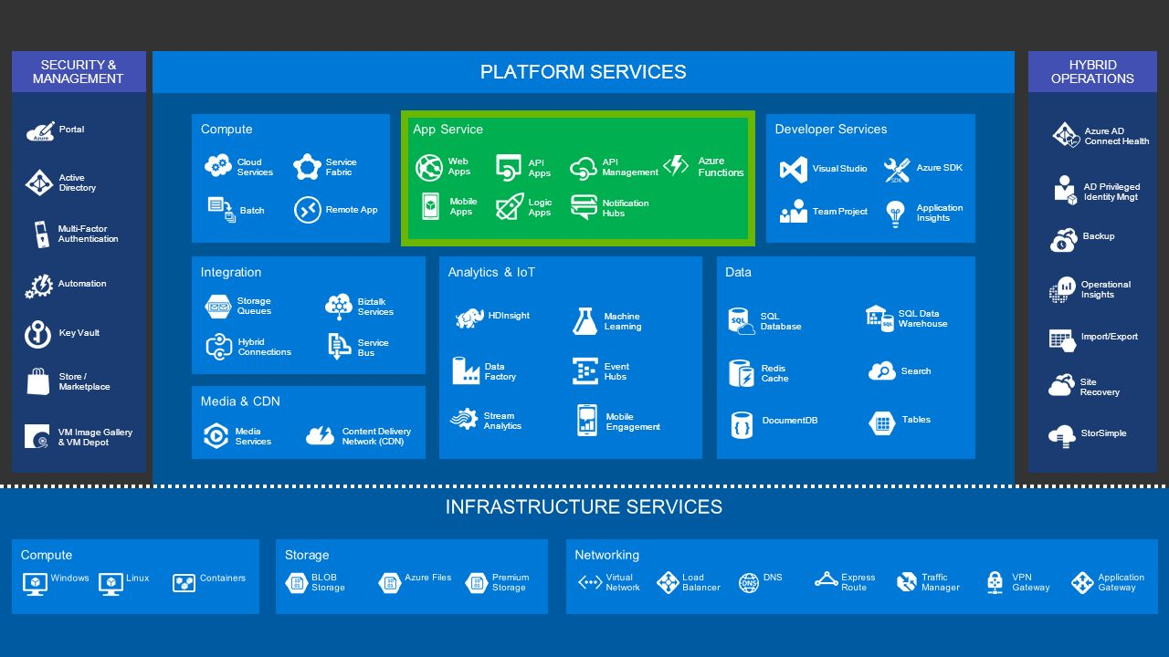
Azure PaaS Rocks!!!

Slide 3
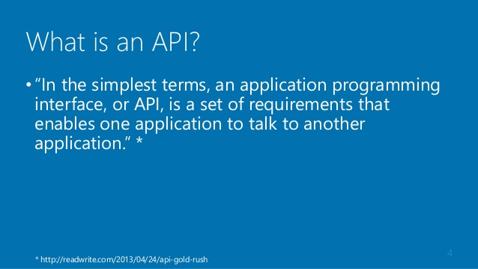
What is an API

Slide 4
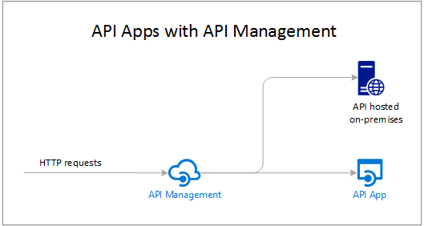
Hi-Level Architecture

Slide 5
What is API Management?
Think PRODUCT…
Product can have many Web APIs and Web API operations (Read, Write, etc…)
Many consumers (users, applications, etc…)
Each consumer has a Subscription in API Management

Slide 6
Features
API Proxy (think light weight ESB)
Publisher & Developer Dashboards/Portals
API Documentation (Swagger)

Slide 7
Features – cont.
API Caching (no code needed)
API Policies
API Telemetry (limited without Event Hub)
API Management REST API Administration

Slide 8
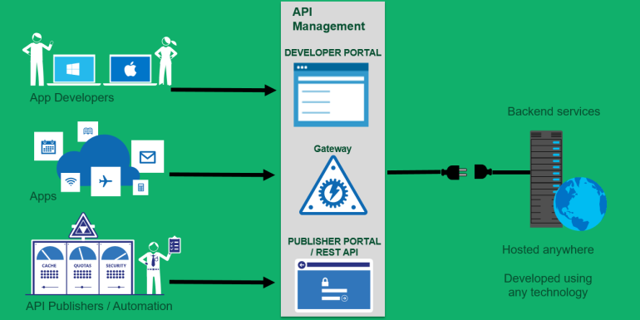
API Ecosystem Architecture

Slide 9
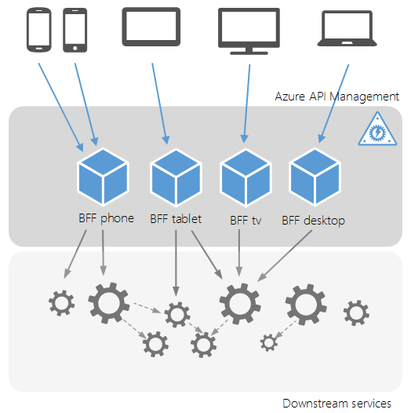
Document the API Landscape

Slide 10
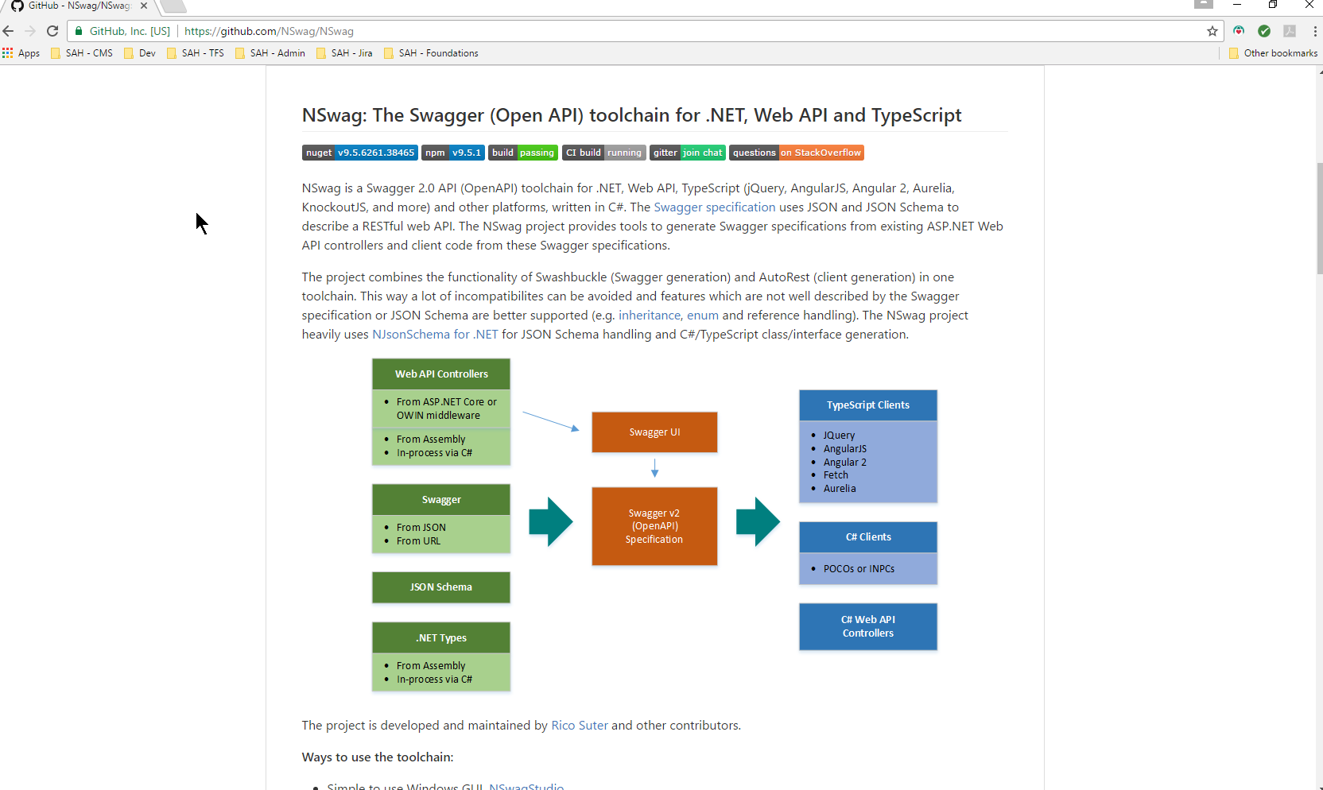
API Documentation Tools, aka swagger
Swashbuckle
NSwag (we don’t need no documentation!)

Slide 11

Swashbuckle

Slide 12
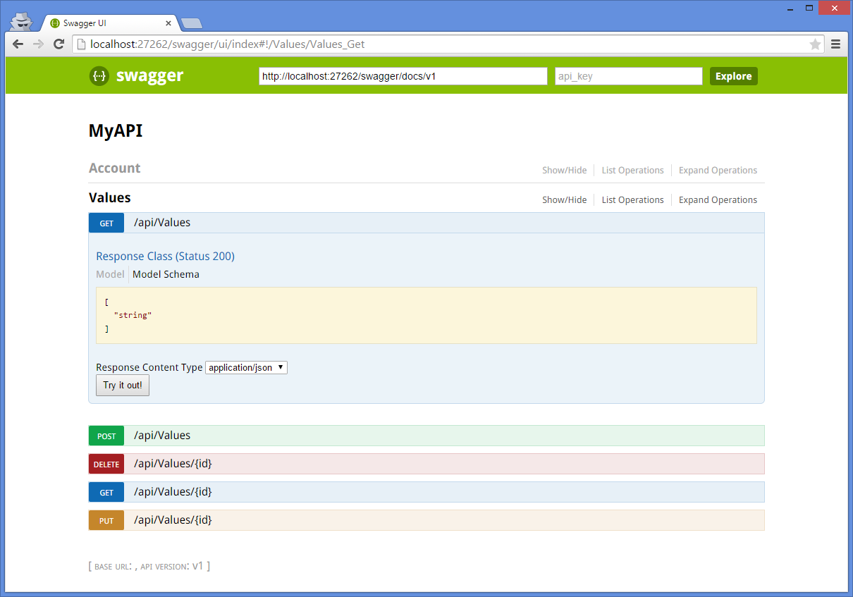
Swashbuckle
Swash what?!

Slide 13
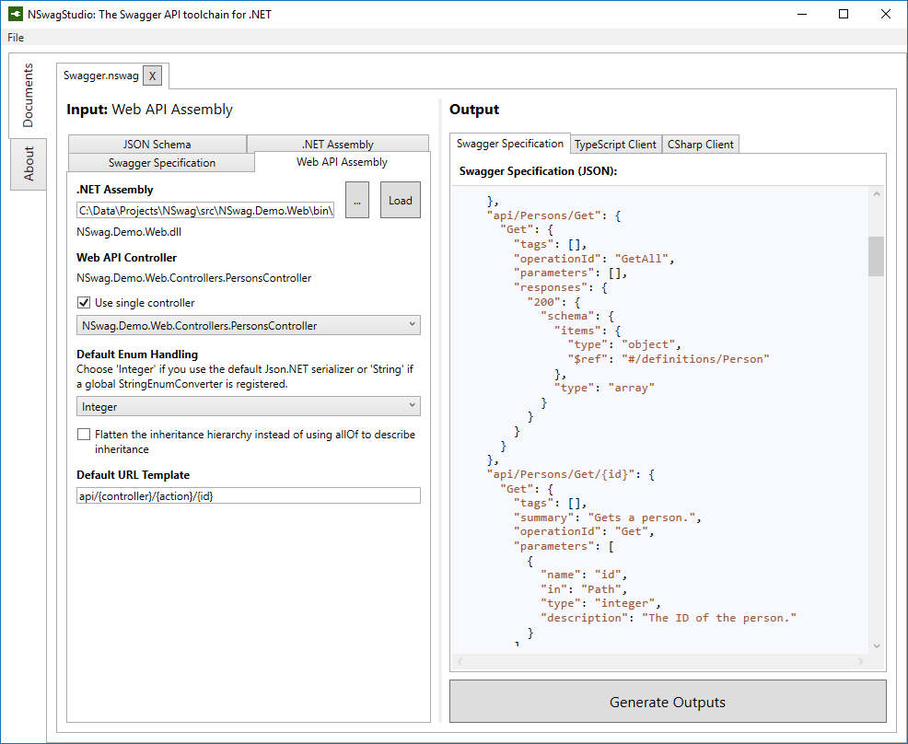
NSwag UI

Slide 14
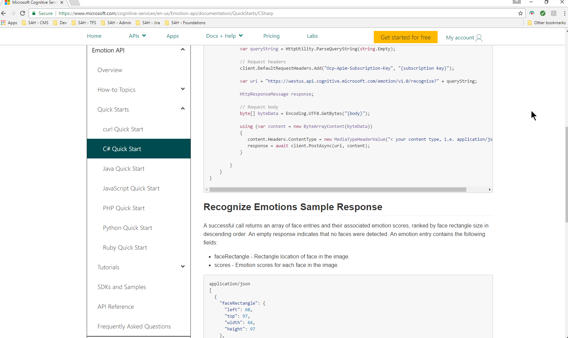
API Documentation Example
Swagger builds better dashboards / portals

Slide 15
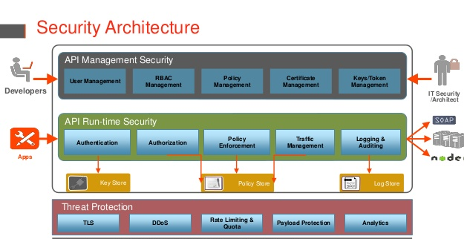
API Policy and Security

Slide 16
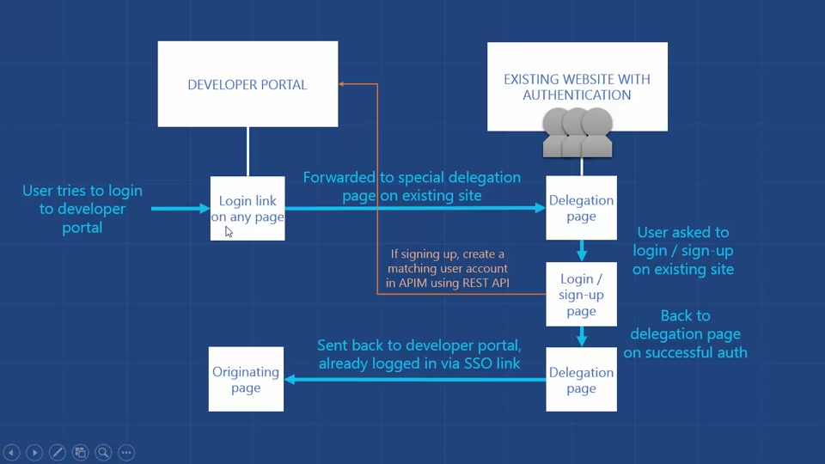
API Azure AD Integration - Security
Notes:
Docs
https://docs.microsoft.com/en-us/azure/api-management/api-management-howto-aad
https://docs.microsoft.com/en-us/azure/api-management/api-management-howto-protect-backend-with-aad#create-a-web-api-service-secured-by-azure-active-directory

Slide 17
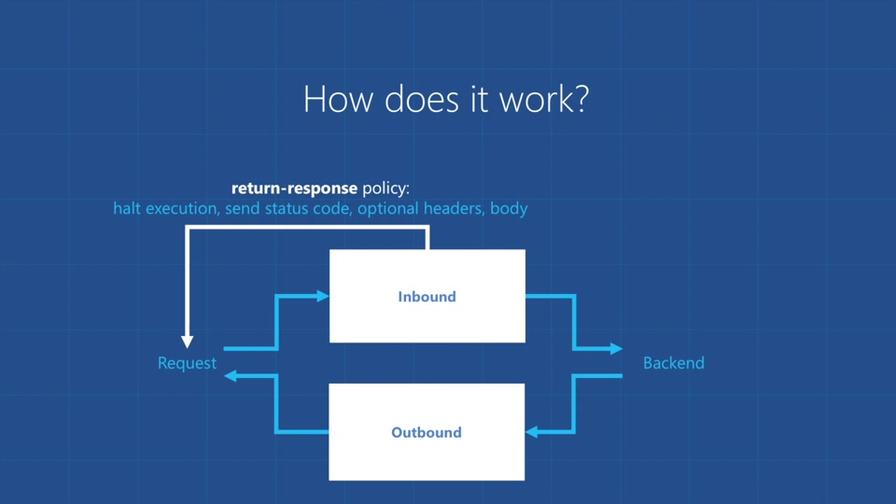
Policy Management - architecture

Slide 18
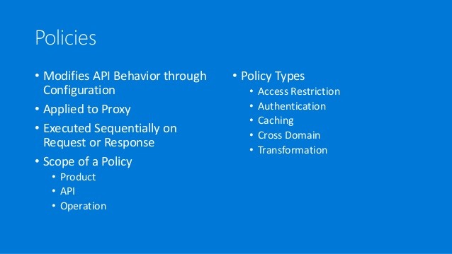
Policies
Notes:
Doc - https://docs.microsoft.com/en-us/azure/api-management/api-management-policies

Slide 19
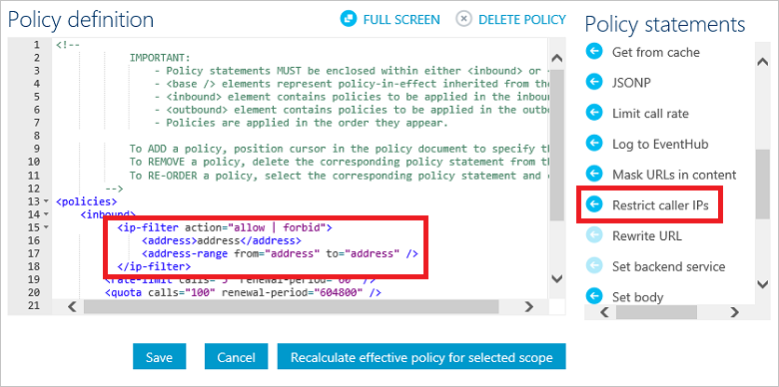
Policy Statements
Notes:
Various policy details - https://docs.microsoft.com/en-us/azure/api-management/api-management-policies

Slide 20
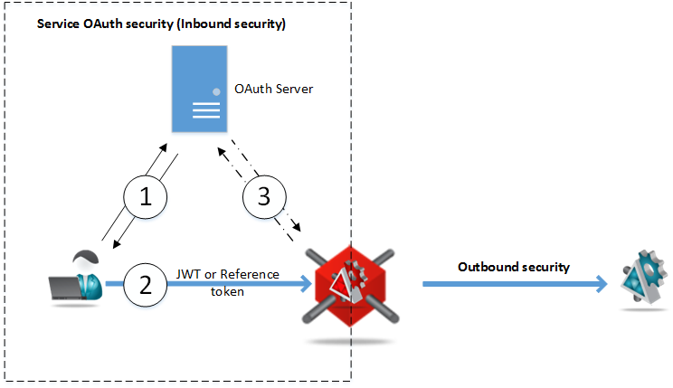
API Security – JSON Web Token
AAD
Oauth
JWT support
Notes:
JWT = JSON Web token
https://jwt.io/

Slide 21
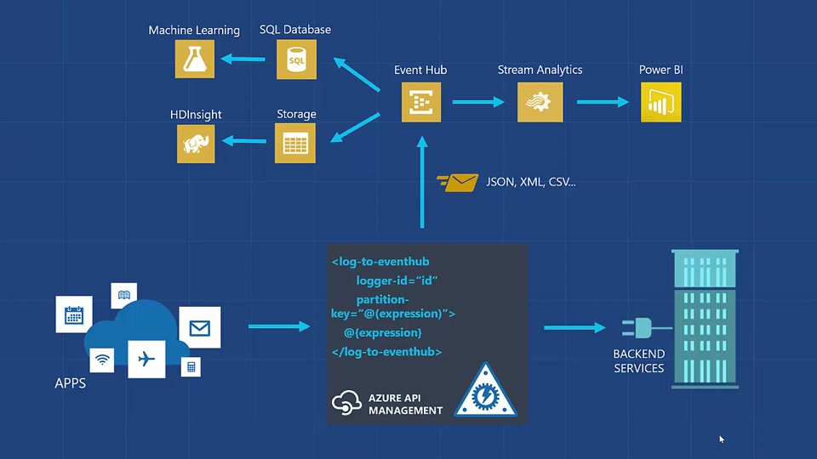
Threat detection / Analytics
Notes:
Azure Stream Analytics:
https://azure.microsoft.com/en-us/services/stream-analytics/
Azure Event Hub:
https://docs.microsoft.com/en-us/azure/event-hubs/event-hubs-what-is-event-hubs

Slide 22
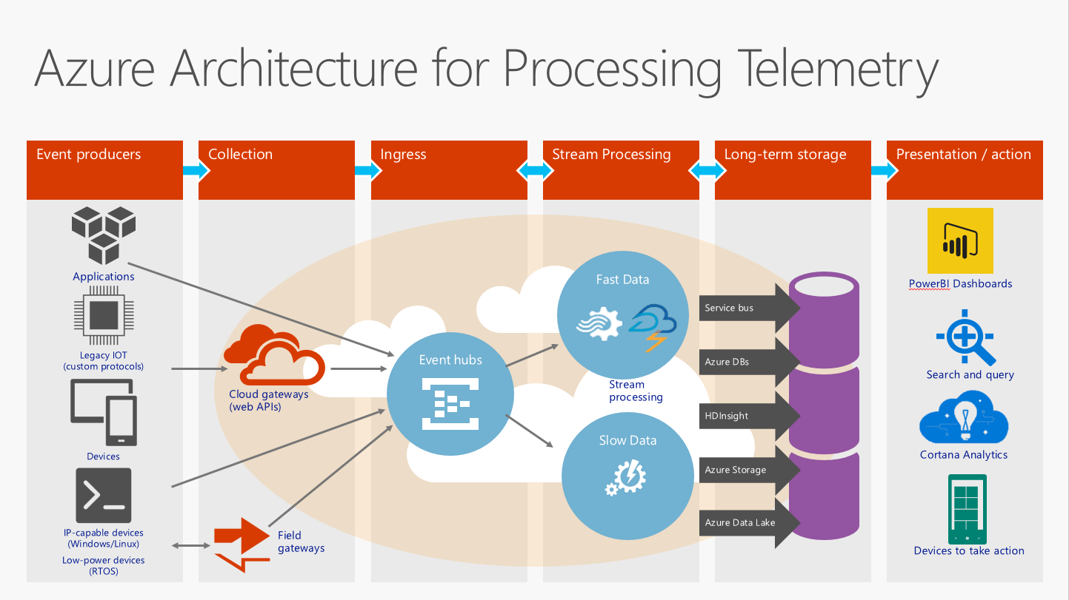
Azure Event Hub
1 million write operations / second

Slide 23
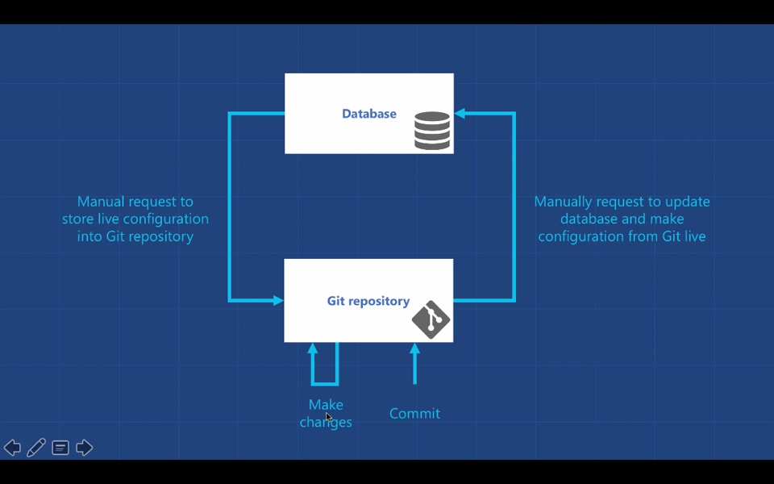
Managing the Management
SCM - Git the entire thing!
Notes:
Git SCM
https://git-scm.com/

Slide 24
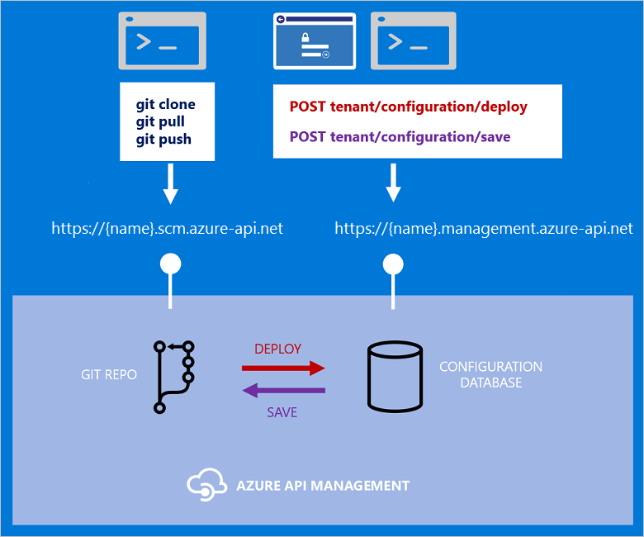
Managing the … (cont.)
CI/CD

Slide 25
Demo

Slide 26
Summary
Two portals - Developer and Publisher
Understanding consumers and their habits, i.e. telemetry data
Provides “edge” caching without code
Provides rich functionality via policies
Provides security with AAD, OAuth and JWT
With additional Azure products (Event Hub & Stream Analytics) can provide real time threat analysis

Slide 27
Questions?

Slide 28
Various images

Slide 29
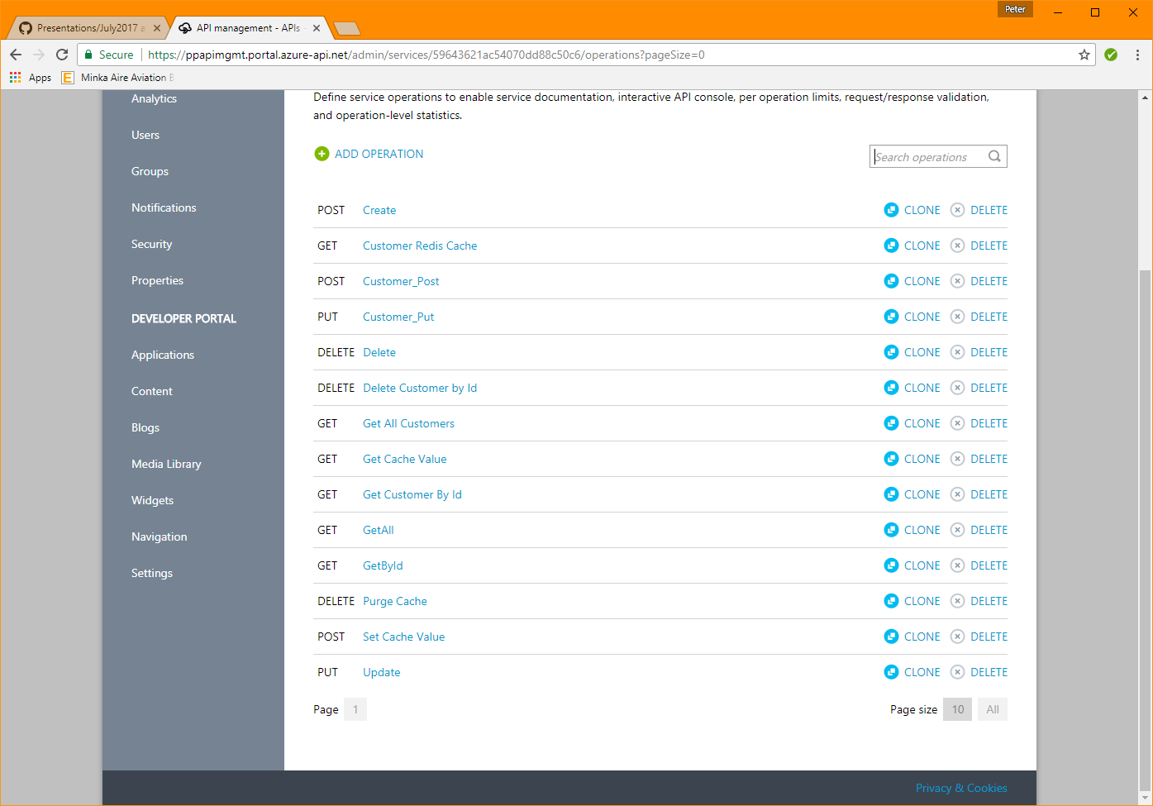
Publisher portal

Slide 30
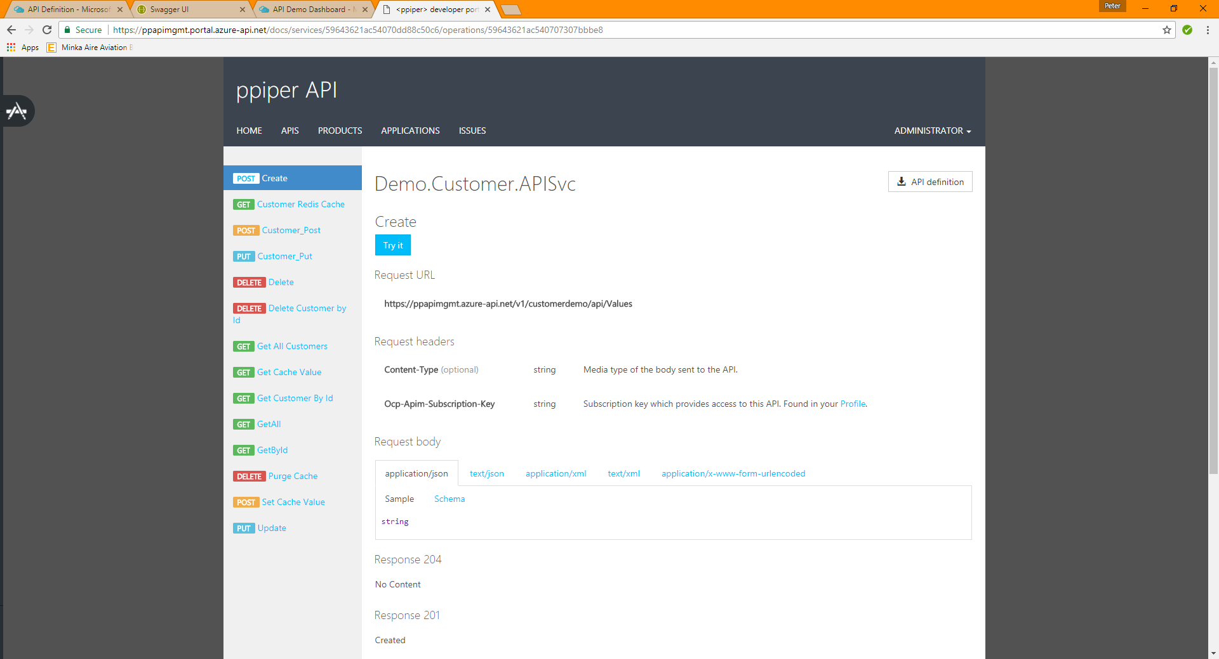
Developer portal

Slide 31
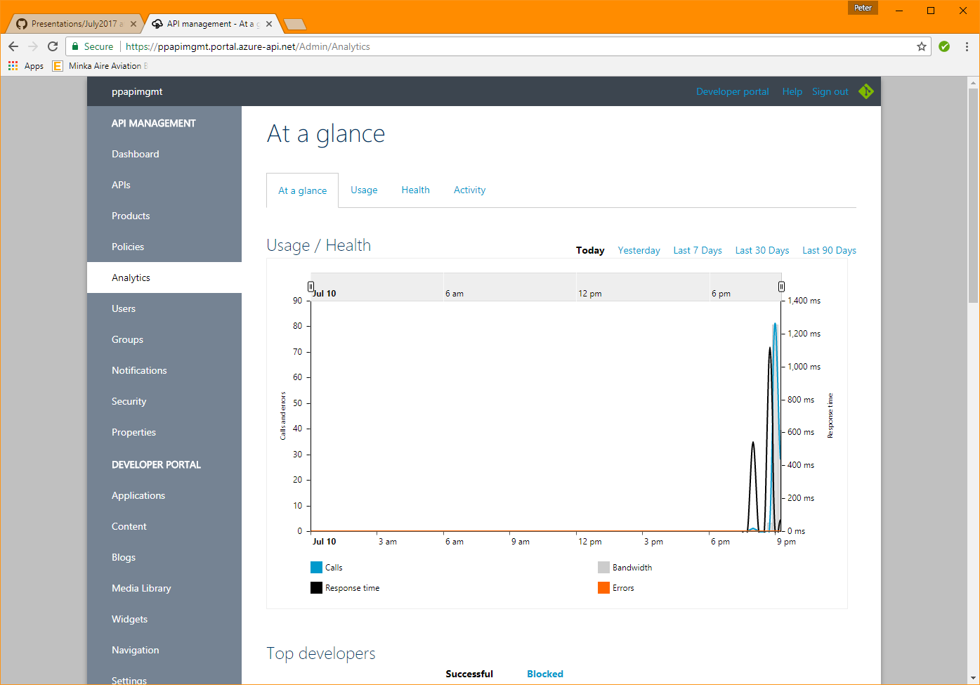
Publisher portal Analytics

Slide 32
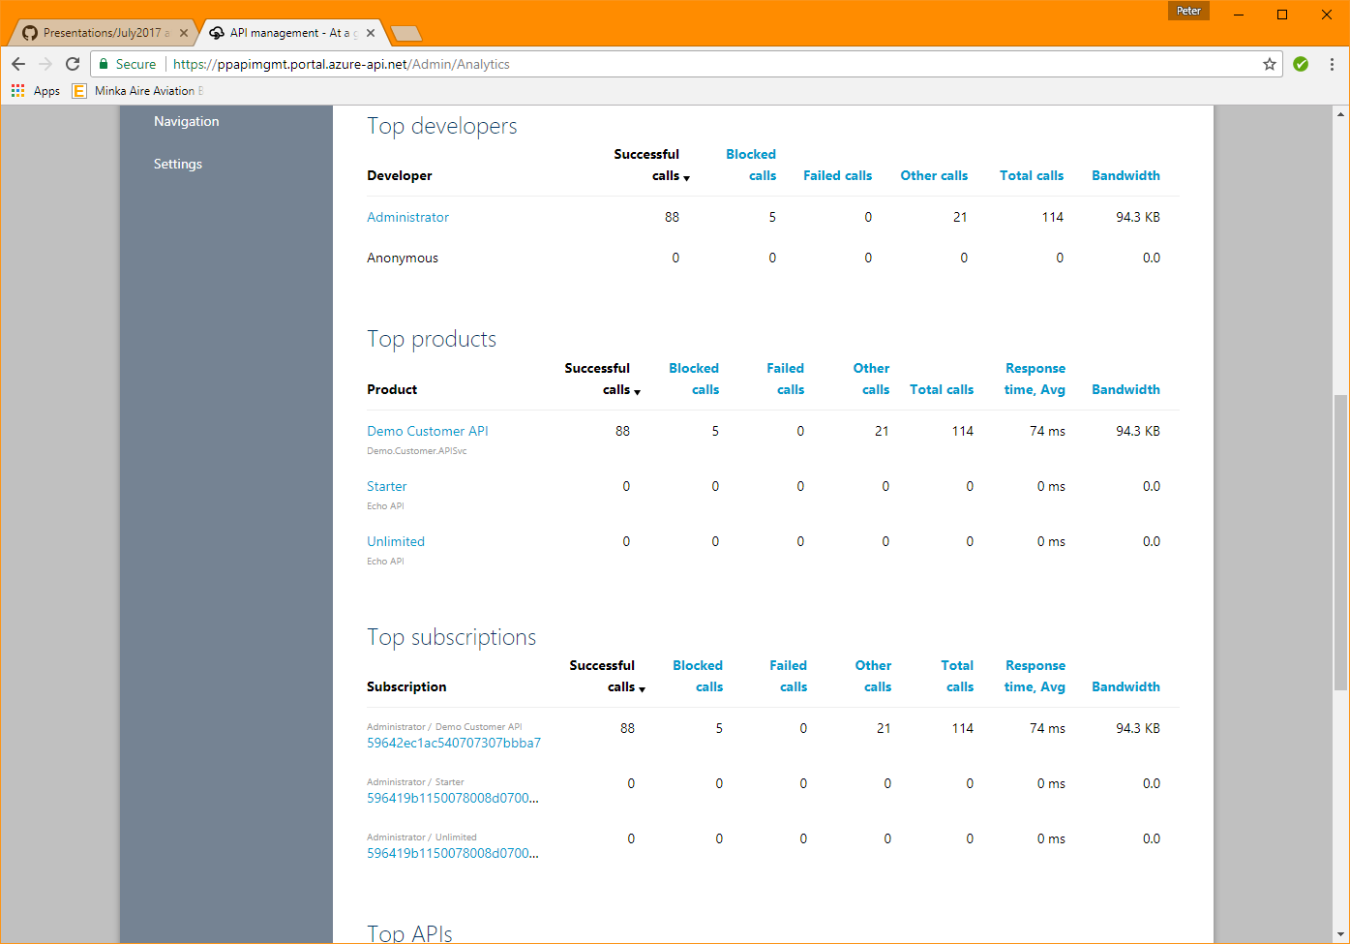
Publisher portal Analytics

Slide 33
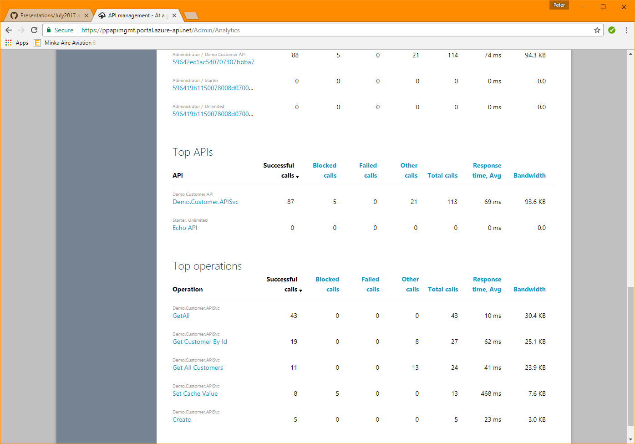
Publisher portal Analytics

Slide 34
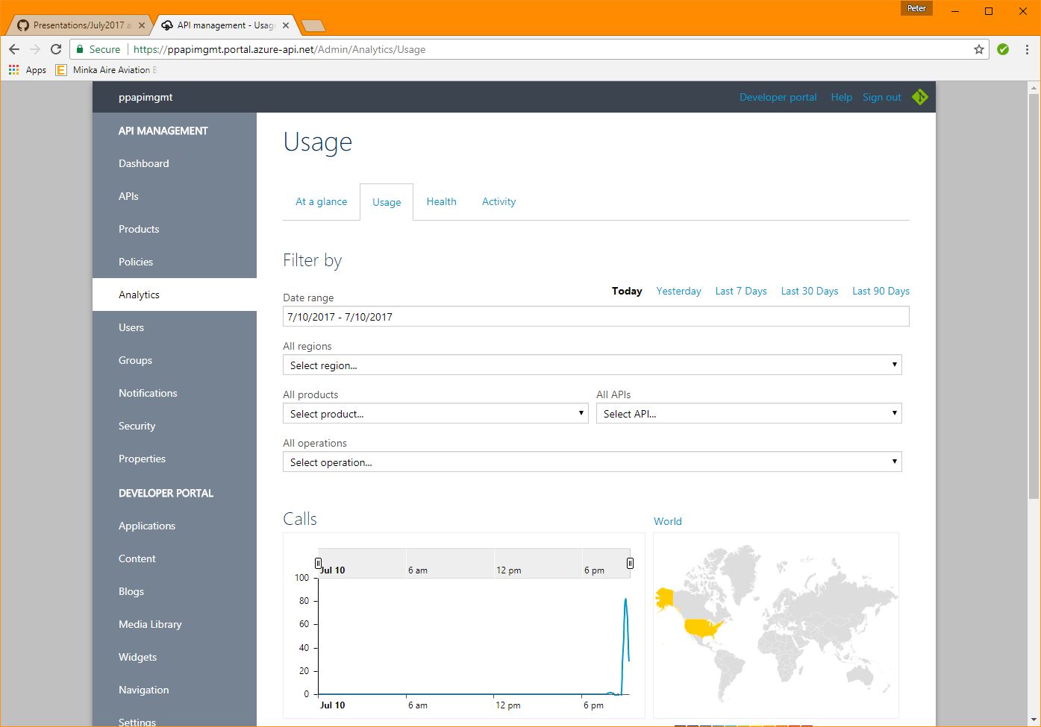
Publisher portal Analytics

Slide 35
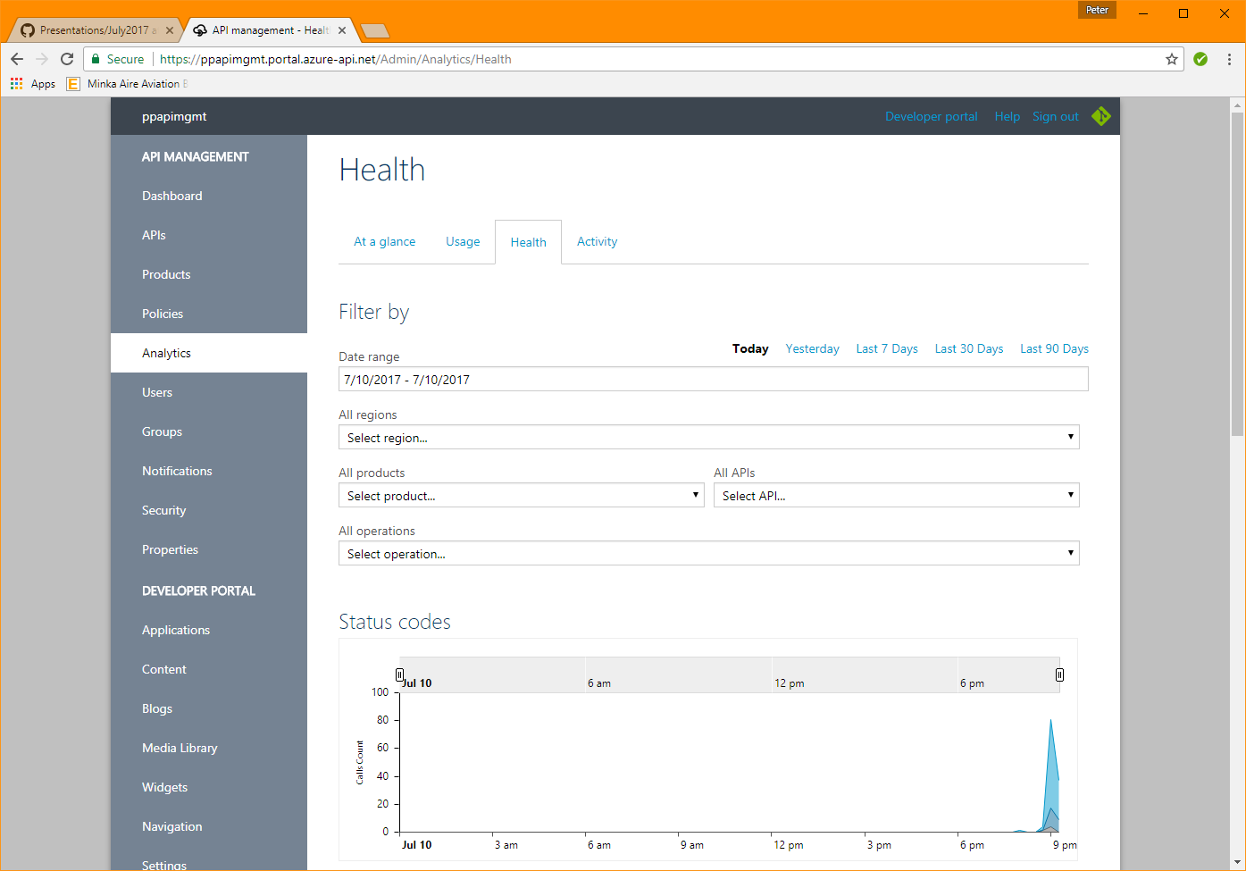
Publisher portal Analytics

Slide 36
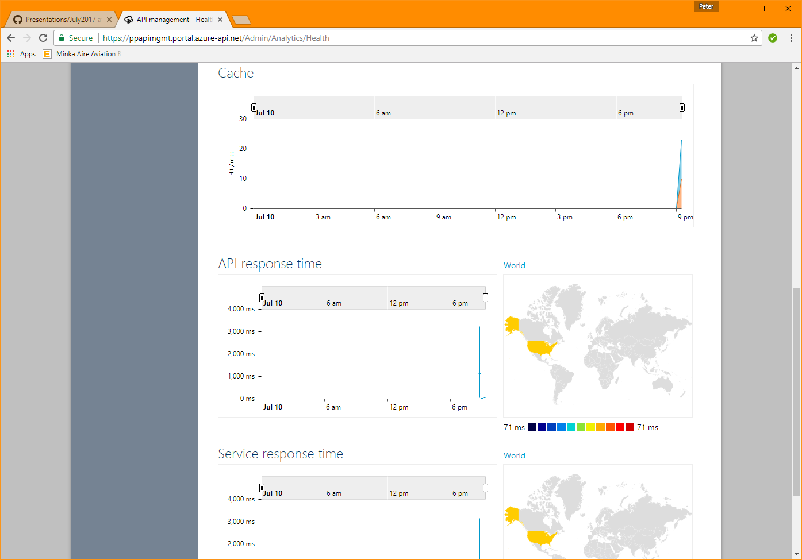
Publisher portal Analytics

Slide 37
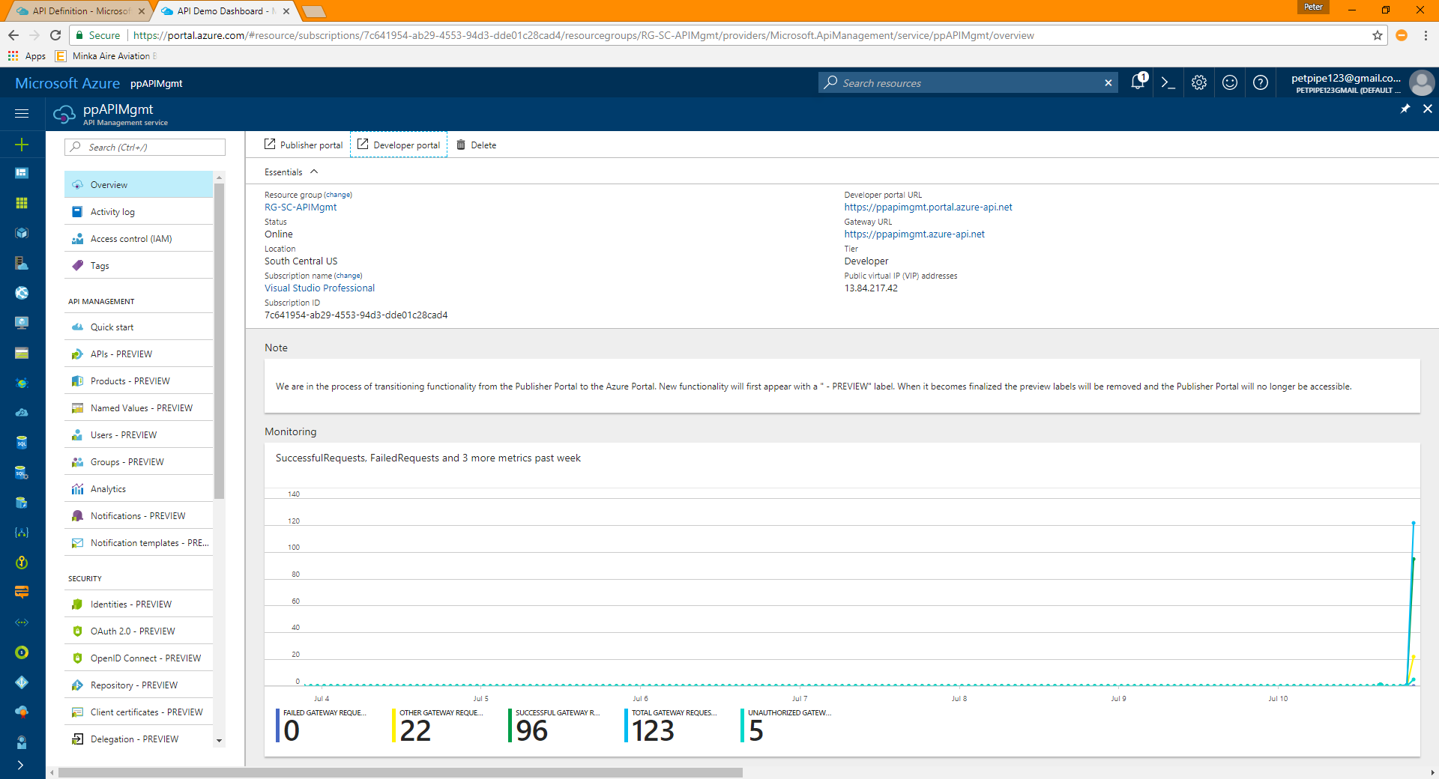
AZURE portal Analytics

Slide 38
Helpful resources
Cloud design patterns - https://docs.microsoft.com/en-us/azure/architecture/patterns/
Plurasight’s Azure API Management course - https://www.pluralsight.com/courses/microsoft-azure-api-management-essentials
Notes:
I’ve touched upon, via the Demo Customer API application, the following patterns:
Application/Connection settings within the PaaS API App is a great way to abstract and secure key / value pairs; however, a better way is to use an:
External configuration - https://docs.microsoft.com/en-us/azure/architecture/patterns/external-configuration-store
Using the “External configuration” pattern, it will avoid the “restart” usually associated when changing application / connection strings values
On the flip-side, a restart may be required due to the nature of the key / value pairs being changed
Implementation using Key-Vault - http://www.techxperiments.com/2017/01/21/cloud-design-patterns-external-configuration-store-pattern-using-azure-key-vault/
Cache-aside pattern - https://docs.microsoft.com/en-us/azure/architecture/patterns/cache-aside
I manually invoke the cache via an API call, but the application can be easily changed to interrogate the cache and “prime the pump” when / if needed.
Strangler / Anti-Corruption Pattern (i.e. abstraction)
https://docs.microsoft.com/en-us/azure/architecture/patterns/strangler
https://docs.microsoft.com/en-us/azure/architecture/patterns/anti-corruption-layer
API Management abstracts consumers from the actual implementation. Think benefits of an ESB.
Good patterns to implement when designing PaaS applications in the cloud:
Retry pattern (Handling Transient Faults) - https://docs.microsoft.com/en-us/azure/architecture/patterns/retry

